Slide 1

Power Platform Governance CoE License Requirements

Slide 2
Disclaimer

Slide 3
Power Apps and Power Automate License Plans

Slide 4
Power Apps standalone plans
Plans and capabilities |  | Power Apps per app plan ^{$5 per user/app/month} | ¹Power Apps per app plan ^{$10 per user/app/month} | Power Apps per user plan ^{$20 per user/month} | Power Apps per app PAYG meter $10 per active user per app/month
Run custom apps / portals | Run custom apps | 1 app or | 2 app and | Unlimited apps | 1 app or
 | Run custom portals | 1 custom portal | 1 custom portal | Unlimited custom portals | 1 custom portal
Connect to your data | Standard connectors | ● | ● | ● | ●
 | Premium and custom connectors | ● | ● | ● | ●
 | On premises data gateway | ● | ● | ● | ●
Store and manage data | Utilize Dataverse | ● | ● | ● | ●
 | Create and access custom tables | ● | ● | ● | ●
 | Dynamics 365 restricted tables access | Read only | Read only | Read only | Read only
Execute flows | Automated, instant, and scheduled flows² | Within app context | Within app context | Within app context | Within app context
 | Business process flows | ● |  | ●
Per license capacity³ | Dataverse Database Capacity³ | 50 MB | 50 MB | 250 MB | 1 GB per PAYG env
 | Dataverse File Capacity³ | 400 MB | 400 MB | 2 GB | 1 GB per PAYG env
 | Daily Power Platform requests⁴ | 6,000 | 6,000 | 40,000 | 6,000
Infuse AI | AI Builder capacity add-on | $ | $ | $ | $
¹ The legacy Power Apps per app plan ($10) will remain on the pricelist through March 31, 2022. Please refer to the FAQ located here for details.
² Power Automate use rights included with Power Apps standalone plans do not include RPA functionality, which requires a separate purchase of Power Automate per user with attended RPA plan
²Dataverse database and file capacity entitlements are pooled at the tenant level
³Service limits are published at http://aka.ms/platformlimits – Power Apps and Power Automate capacity add-on can be purchased to increase daily service limits

Slide 5
Power Automate (Flow) within app context
Definition of Flow within app context
For both triggers and actions, Flows included within an embedding application can connect:
To any data source within the use rights of the embedding application.
Directly with the embedding application (via built in trigger/action).
Example: Flow embedded within Power Apps
Example: Flow within app context.
Example: Flow NOT within app context.
User with a standalone Power Apps license runs an app that uses SQL DB as the data source and includes Flows that:
Read from OR write to SQL DB.
Use a built-in Power Apps trigger and/or action. For example: Send a push notification to the app.
The same user now also wants to use a Flow that updates an Oracle database and,
is completely unrelated to the Power Apps app.
does not interact in any way with the Power Apps app (or its data sources).
This user will then require a standalone flow.

Slide 6
Power Apps per app pay-as-you-go (PAYG)
Power Apps per app pay-as-you-go
Entitlements: Dataverse database (1 GB) and file (1 GB) capacity entitlements are applied to each environment with pay-as-you-go billing enabled and are not granted for each monthly active user.
$10 per active user per app/month
Dataverse capacity add-on meters:
Dataverse Database capacity – $48 per GB/month
Dataverse File capacity – $2.40 per GB/month
Dataverse Log capacity – $12 per GB/month
Best for businesses that want to license active users for each app¹ they run and pay later based on consumption
¹Power Apps per app pay-as-you-go meter entitles licensed user to run 1 app or 1 portal
Power Apps & Power Automate for Office 365 and Dynamics 365 allow users to customize & extend Office 365 and Dynamics 365 applications. For more information, please see Office 365 / Dynamics 365 sections in this deck.

Slide 7
Power Apps for Office 365 (seeded license)
Plans and capabilities | Power Apps for Office 365
Run custom apps/portals | Run custom apps (canvas apps) | Unlimited
 | Run custom apps (model driven apps) | -
 | Access custom portals | -
Connect to your data | Standard connectors | ●
 | Premium and custom connectors¹ | -
 | On premise data gateway | -
Store and manage data | Utilize Dataverse for Teams (use for apps in Teams only) | Select O365 licenses
 | Utilize Dataverse (formerly Common Data Service) | -
 | Create and access custom tables (includes complex tables) | -
Execute flows | Power Automate use rights (See Power Automate with Office 365 section) | ●
Per license capacity | Dataverse Database Capacity | -
 | Dataverse File Capacity | -
 | Daily Power Platform requests¹ | 6,000
¹ Reference http://aka.ms/platformlimits for more details on usage limits; “Power Apps and Power Automate capacity add-on” can be purchased to increase daily service limits.

Slide 8
Power Automate standalone plans
Plans and capabilities |  | Per user plan ^{$15 per user/month} | Per user with attended RPA plan ^{$40 per user/month} | Per flow plan ^{$100 per flow/month} ^{Min purchase of 5 flows}
Execute flows | Cloud flows (Automated, instant, and scheduled) | l | l | l
 | Business process flows | l | l | l
 | Attended desktop flows | - | l | -
 | Unattended desktop flows | - | - | -
 | WinAutomation client capabilities | - | l | -
Visualize and analyze processes | Process advisor | ● | ● | -
Share and collaborate | Applies to flows included in the license | ● | ● | -
Connect to your data | Standard connectors | ● | ● | ●
 | Premium and custom connectors | ● | ² | ²
 | On premises data gateway | ● | ● | ●
Store and manage data | Utilize Dataverse | ● | ● | ●
Per license capacity¹ | Dataverse Database Capacity³ | 250MB | 250MB | 50MB
 | Dataverse File Capacity³ | 2GB | 2GB | 200MB
 | Daily Power Platform requests¹ | 40,000 | 40,000 | 250,000
Infuse AI | AI Builder capacity add-on⁴ | $ | 5,000 | $
¹ Reference http://aka.ms/platformlimits for more details on usage limits; “Power Apps and Power Automate capacity add-on” can be purchased to increase daily service limits.
² Desktop flow connector included (it is not included in Windows licenses)
³ Additional Dataverse Database/File/Log capacity can be purchased in increments of 1GB. Dataverse Database and File capacity are pooled tenant wide.
⁴ Additional AI Builder capacity can be purchased per 1M service credits for $500/month; AI Builder service credit capacity is pooled on the tenant level.

Slide 9
Power Automate for Office 365 (seeded plan)
Plans and capabilities | Power Automate for Office 365
Execute flows | Automated, instant, and scheduled flows | ●
 | Business process flows | -
Connect to your data | Standard connectors | ●
 | Premium and custom connectors | -
 | On-premises data gateway | -
Store and manage data | Utilize Dataverse for Teams (use for flows in Teams only) | Select Office 365 licenses
 | Dataverse (formerly Common Data Service) use rights | -
Per license capacity | Daily Power Platform requests¹ | 6,000
¹ Reference http://aka.ms/platformlimits for more details on usage limits; “Power Apps and Power Automate capacity add-on” can be purchased to increase daily service limits.

Slide 10
Power Apps and Automate capacity add-on
Overview
Power Apps and Power Automate capacity add-on increases the daily Power Platform requests for Power Apps, Power Automate, Power Virtual Agents, and Dynamics 365 users/workloads that consistently exceed their daily service limits.
Note: Service limits are for service protection purposes and set to high thresholds so that users with normal usage patterns will be well within the limits. Please see http://aka.ms/platformlimits for more details
Offer Details
Offer name | Power Apps and Power Automate capacity add-on
License type | Dedicated capacity per user/flow
Pricing | $50 per unit per month
Unit capacity | Each unit provides 10,000 daily Power Platform requests
Assignment of purchased capacity | In product

Slide 11
Dataverse capacity add-on
Overview
Apps or flows utilizing Dataverse will consume varying quantities of Database Capacity, File Capacity, and Log Capacity and may require different kinds of Power Apps and Power Automates environments. Apps may utilize flows, or flows may be run separately from apps.
Offer Details
Dataverse Database capacity (1GB) | 40$ per month
Dataverse File capacity (1GB) | 2$ per month
Dataverse Log capacity (1GB) | 10$ per month
Please note that Dataverse capacity add-ons do not apply to Dataverse for Teams scenarios (i.e., when a Dataverse for Teams environment reaches its limit, customers need to step up to standalone Power Apps, Power Automate, or Power Virtual Agents plans for additional capacity).

Slide 12
Center of Excellence Starter Kit Licensing Requirements

Slide 13
Center of Excellence Starter Kit Licensing Requirements
Microsoft 365 license like E1/E3/E5 is required to use Office 365 connectors like Outlook, SharePoint and Groups
Center of Excellence Starter Kit in Production environment
Premium licenses are required for all users interacting with the CoE Starter Kit
Depending on what components you will use, your organization size and the existing licenses available in your organization, you will require either a Power Apps per user or per app or Power Automate per user or per flow license or a combination of these licenses.
Dataverse for Teams CoE
Power Automate per user license will be required for the admin running the sync flows
No additional licenses will be required for users interacting with any of the canvas apps

Slide 14
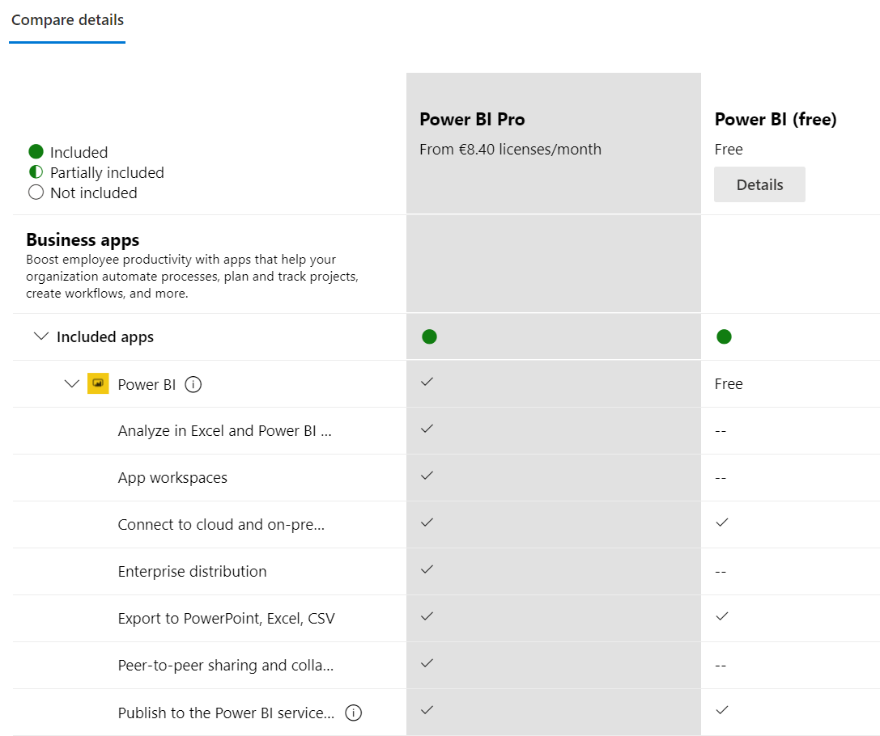
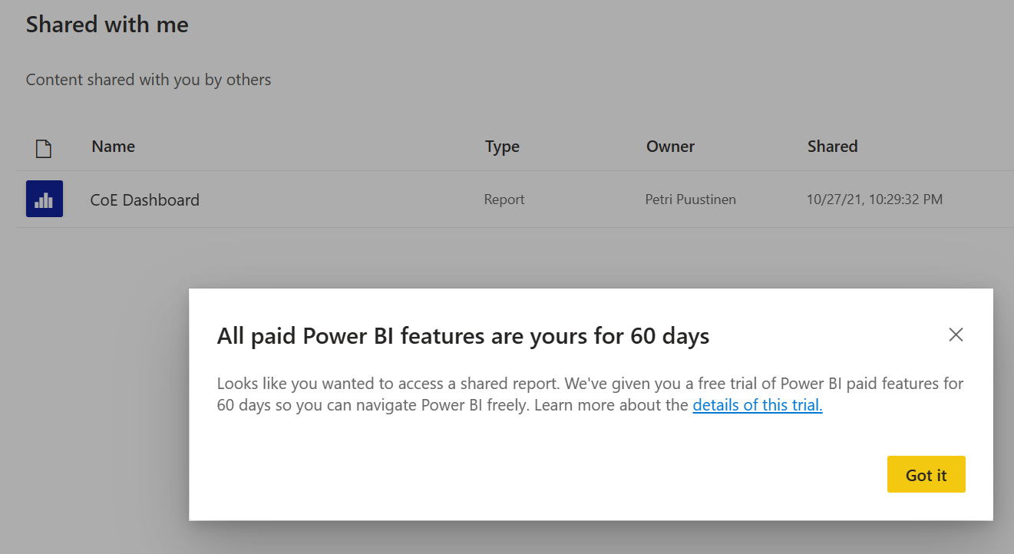
Power BI Dashboard
Center of Excellence (CoE) Starter Kit Power BI Dashboard can be used with Power BI Free license, but with free license you are not able to share reports
With free license you can use report in Power BI Desktop and/or publish the report to your own personal Power BI workspace
Power BI Pro or Premium is need to be able to share reports to others and open shared reports

Slide 15
Microsoft

